Slide 1


ISI Training Project
Topic :
Project Submitted to
GITAM School Of Science, GITAM University Hyderabad
By
C. Nandita – 2023001442
M. Sai Dheeraj - 2023002482
K. Rithika - 2023002986
Shazia - 2023003578
MSc. Data Science II Year
2024-2025

Slide 2
PROBLEM STATEMENT
This project focuses on analyzing data from a restaurant to find ways to increase revenue. By looking at customer habits, and busy times, we aim to identify trends that can help the restaurant make better decisions.
METHODOLOGY
We have used linear regression algorithm to analyse the relationship between the feature “Bill” and other features to understand what affects the revenue of the restaurant.
The method we used is Ordinary Least Squares to identify the best fit for the given data.

Slide 3
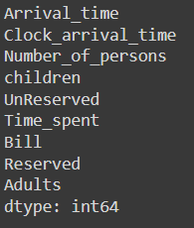
DATA DESCRIPTION
We were provided with the Restaurant dataset which contains the data of 5 days.
The following are the features of the dataset:
Numerical Columns: Arrival_time, Clock_arrival_time, Number_of_persons, children, Time_spent, Bill, Adults
Categorical Columns: UnReserved, Reserved

Slide 4
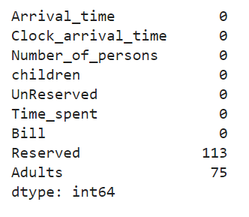
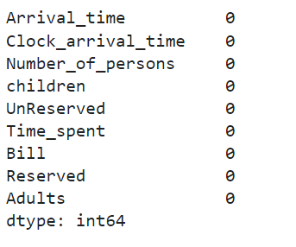
Before and After Data Cleaning

Slide 5
OBJECTIVES
Calculating waiting time
Reserved + Number of persons vs Bill
Number of Adults vs Bill
Number of Children vs Bill
Calculating maximum and average waiting time
Calculating peak time when there are maximum number of customers
Calculating highest bill for each day
Calculating the number of reserved and non-reserved tables for each day

Slide 6
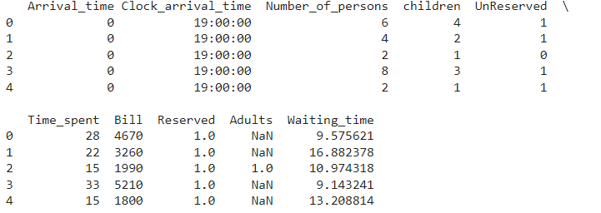
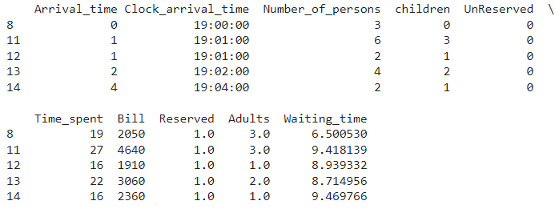
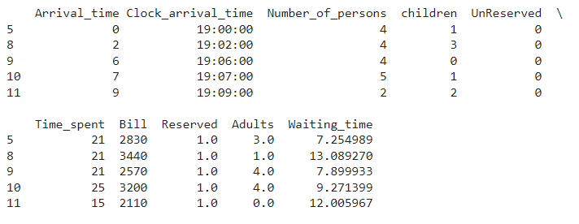
Adding Waiting Time
Day - 1
Day - 2
Day -3

Slide 7
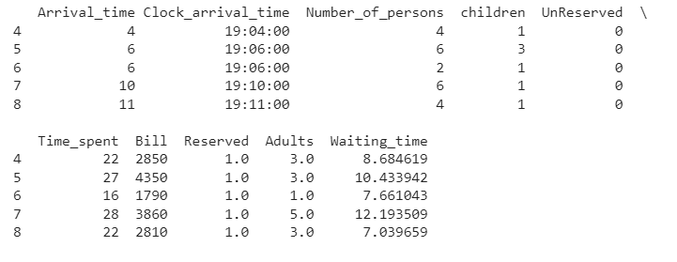
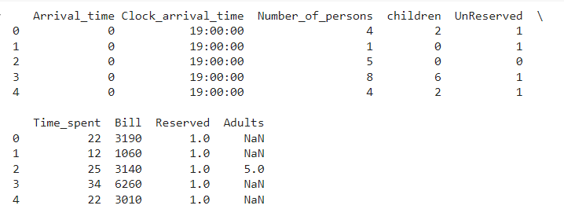
Day - 4
Day - 5

Slide 8
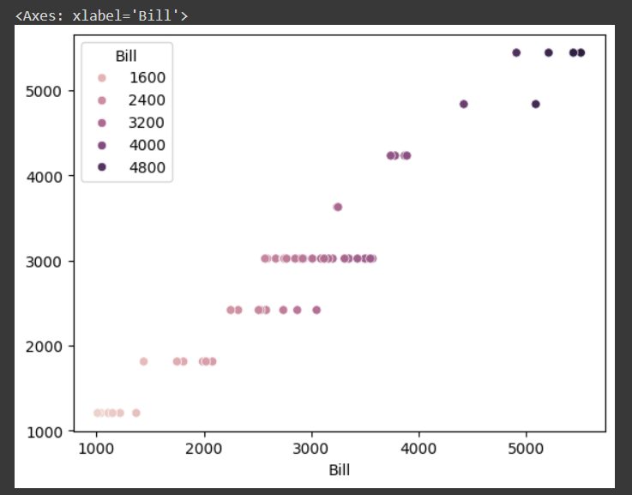
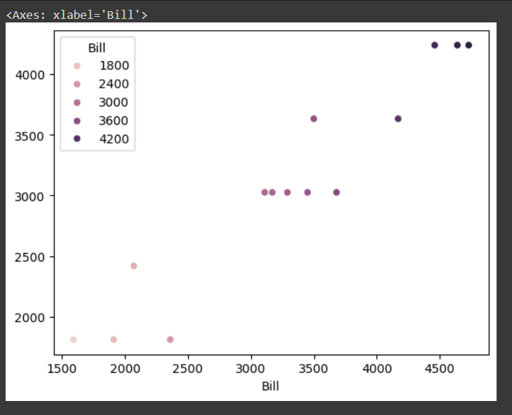
Relationship between Reserved + Number of persons Vs Bill
Day-1
Day-2
R-Squared – 0.919
R-Squared – 0.915
Average Bill – 2558.6965
Average Bill -3068.5823
Maximum Bill – 4823.1024
Maximum Bill – 4239.1656

Slide 9
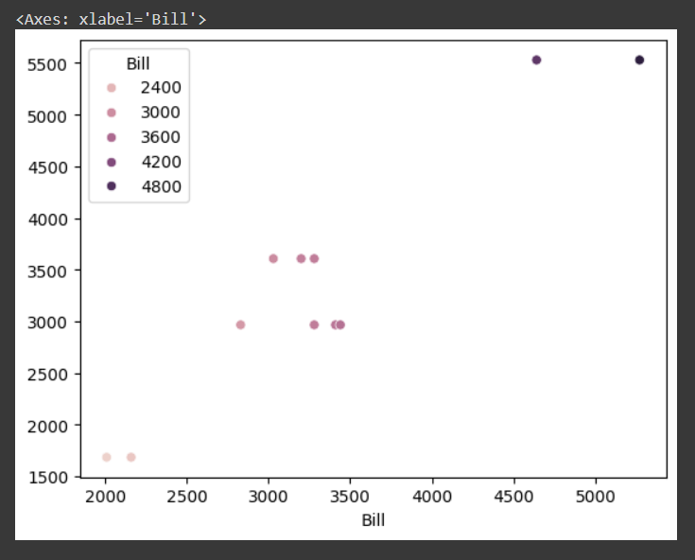
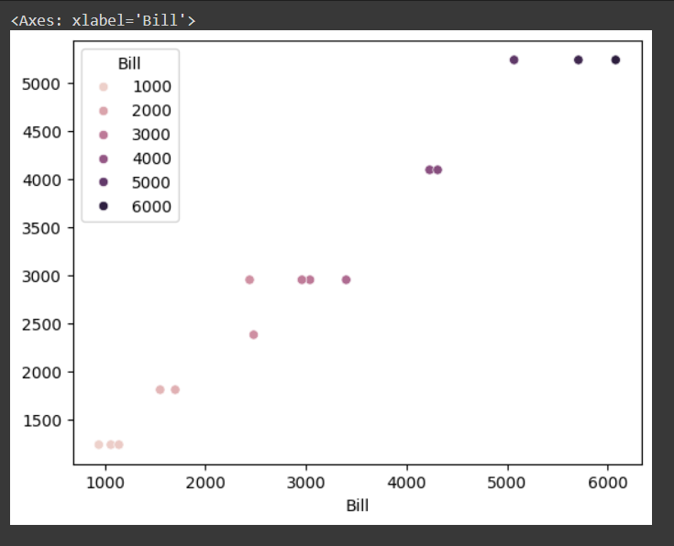
Day-3
Day 4
R-Squared – 0.924
R-Squared – 0.960
Average Bill – 3373.3791
Average Bill – 3027.8376
Maximum Bill – 5528.6251
Maximum Bill – 5232.9612

Slide 10
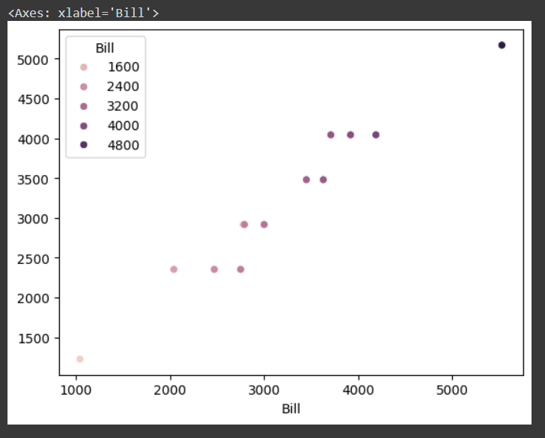
Day 5
OBSERVATIONS:
Based on the R- Squared values we can say that the model is a good fit on day 4 as its value is 0.960
Since this value is significantly higher for 4th day compared to others, it implies that on this day, factors like the number of persons and reservation status had a stronger or more consistent impact on how bills were generated.
This could be due to specific operational factors (e.g., a higher number of group reservations, discounts applied based on reservations, etc.) or other contextual reasons that made the relationship more pronounced.
We can also observe Day 3 has the highest bill. Hence the restaurant should focus on coming up with more offers on this day to get more profit.
R-Squared – 0.950
Average Bill - 3176.6562
Maximum Bill - 5170.9446

Slide 11
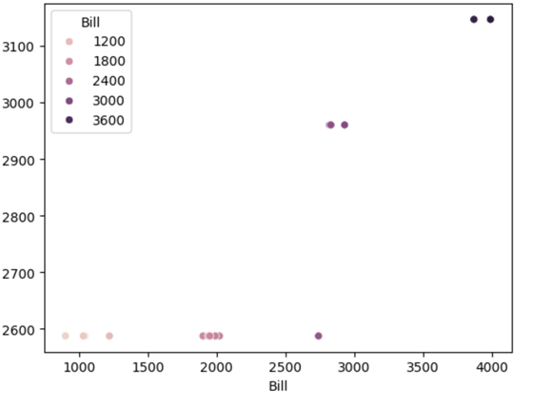
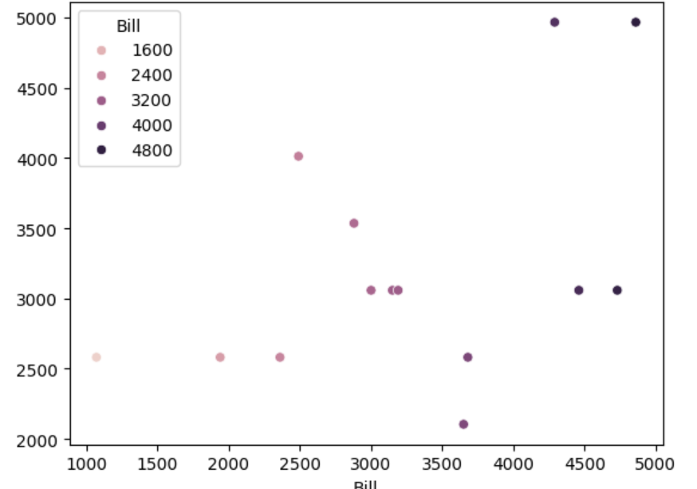
Number of Adults VS Bill
Day - 1
Day -2
R-Squared – 0.205
R-Squared – 0.221
Average Bill – 2727.2182
Average Bill – 3229.1160

Slide 12
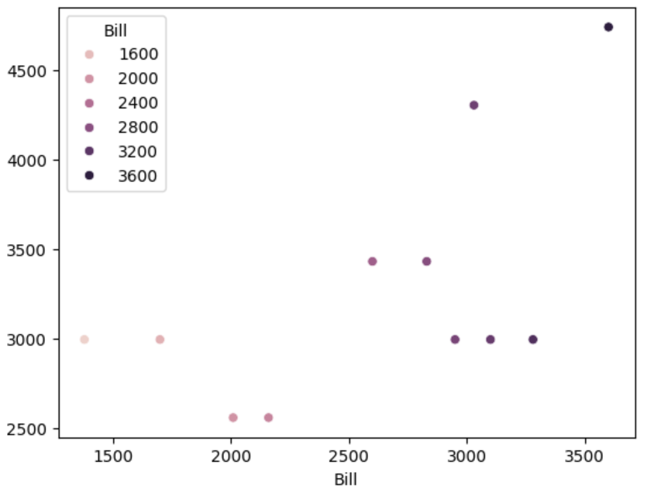
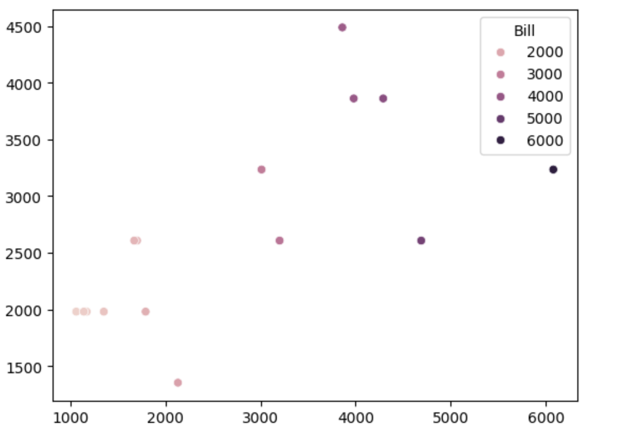
Day- 3
Day- 4
R-Squared – 0.254
R-Squared – 0.491
Average Bill – 3272.2809
Average Bill – 2619.1070

Slide 13
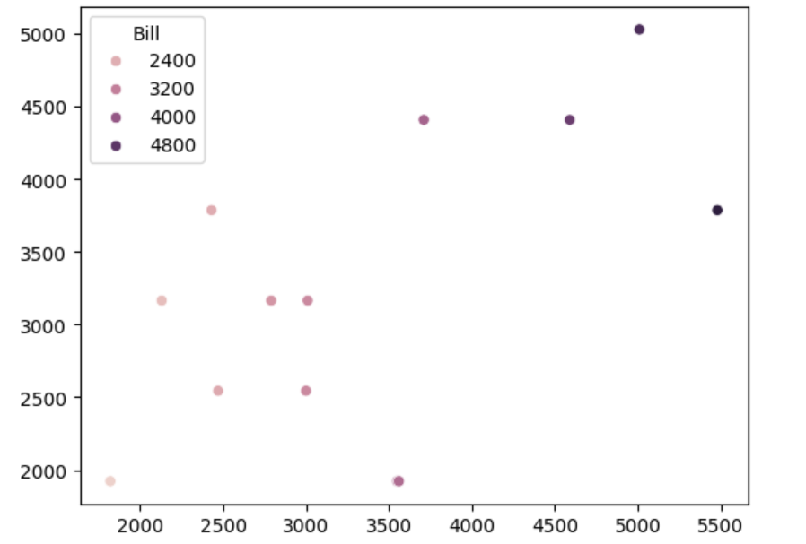
Day - 5
OBSERVATIONS
The value 0.491 indicates a moderate level of explanatory power. The model does not explain all of the variance in the "Bill," but it explains nearly half of it.
There is a moderate relationship between “Number of Adults" and "Bill." Other factors or variables likely play a significant role in determining the bill amount.
We can also observe Day 3 has the highest average bill. Hence the restaurant should focus on the capacity to accommodate more adults, whether through better space management, reduced wait times, or targeted marketing that boosts adult bookings.
R-Squared – 0.460
Average Bill – 3212.5114

Slide 14
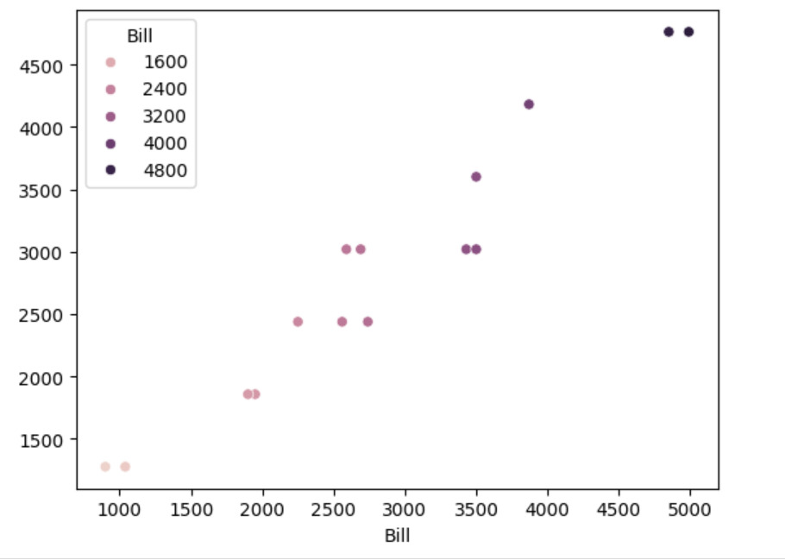
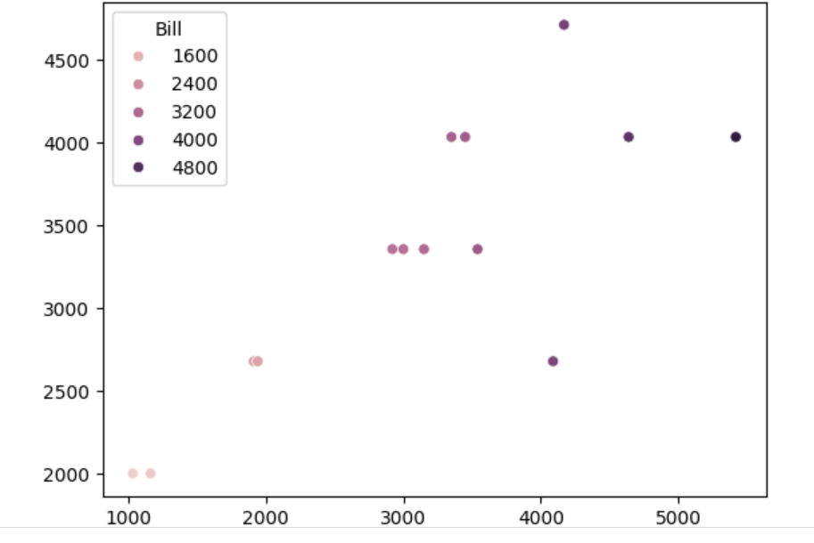
Number of Children VS Bill
Day- 1
Day -2
R-Squared – 0.653
R-Squared – 0.653
Average Bill – 2037.4608
Average Bill -3306.0137

Slide 15
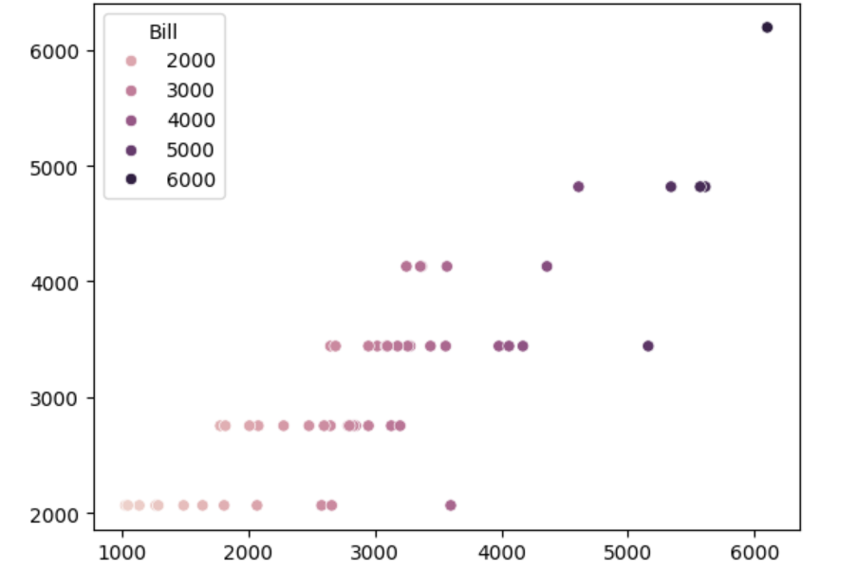
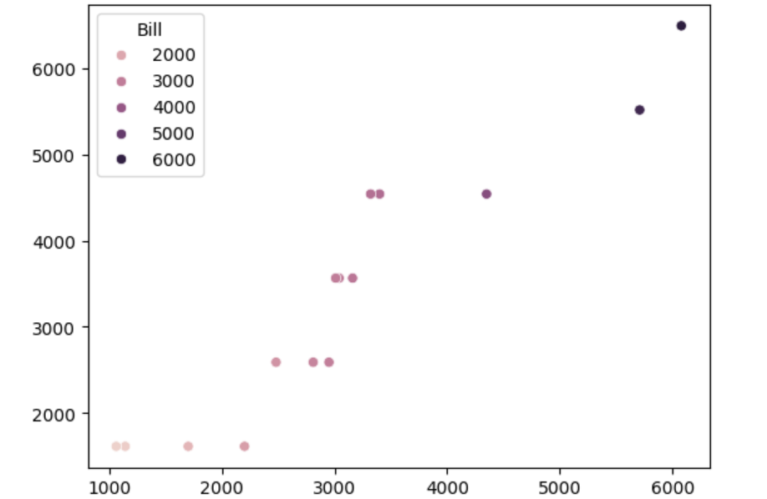
Day- 3
Day - 4
R-Squared – 0.644
R-Squared – 0.765
Average Bill – 3122.3570
Average Bill – 3370.2120

Slide 16
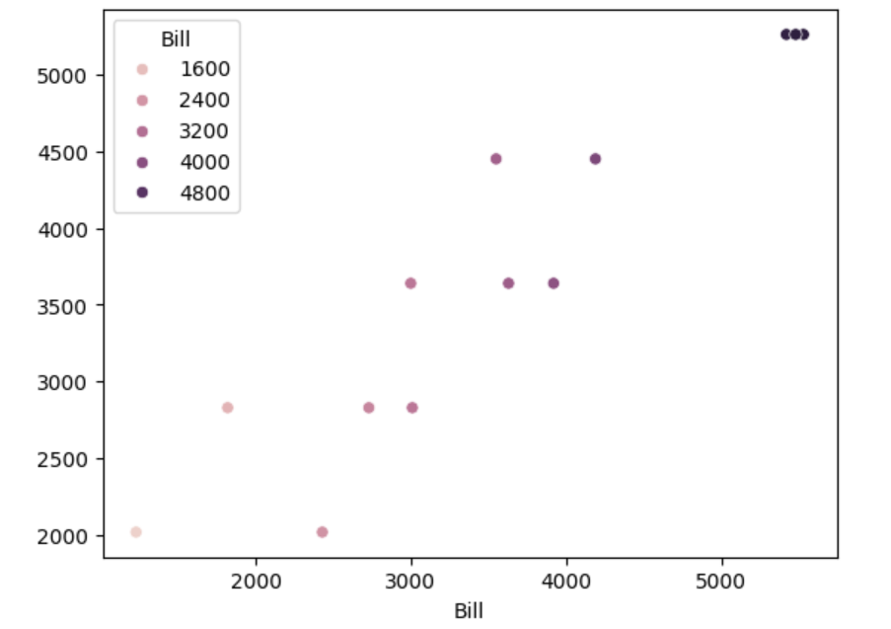
Day- 5
OBSERVATIONS
Based on the R- Squared values we can say that the model is a good fit on day 4 as its value is 0.765.
76.5% of the changes or differences in the "Bill" amount can be attributed to the variables “Number of children“.
The remaining 23.5% of the variance is due to other factors not included in the model or randomness.
We can also observe Day 5 has the highest average bill. Hence the restaurant should introduce child-centric offers and discounts.
R-Squared – 0.665
Average Bill - 3701.2870

Slide 17
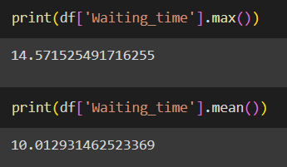
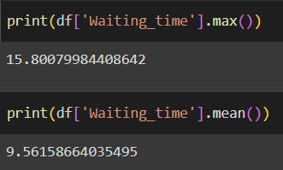
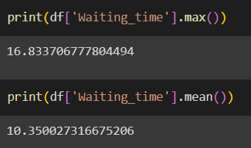
Calculating maximum and average waiting time
DAY – 1
DAY -2
DAY -3

Slide 18
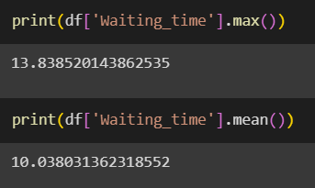
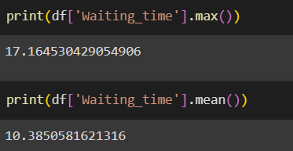
DAY - 4
DAY - 5
OBSERVATIONS
Maximum waiting time and average waiting time is on Day-5
There may be a high number of customers on Day 5, leading to longer waiting times due to high demand for services, tables, or resources. The systems or staff may struggle to accommodate the influx of customers, resulting in delays in seating or service.
Longer waiting times can negatively impact customer satisfaction, leading to a poorer overall experience if not managed well.

Slide 19



Calculating the Peak Time when there are high number of
customers
DAY - 1
DAY - 2
DAY - 3

Slide 20


DAY - 4
DAY - 5
OBSERVATIONS
It can be observed that the restaurant had highest number of people on Day 5 at 7:55 PM
Day 5 experiences the highest influx of customers, which could be due to a variety of factors like promotions, events, or typical patterns in customer behavior.
This day likely represents a time when demand is at its highest, providing an opportunity to optimize resources and maximize revenue.

Slide 21
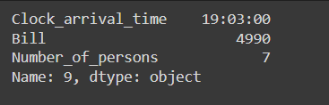
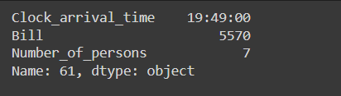
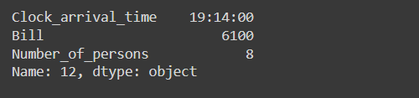
Calculating Highest Bill Per Day
DAY - 1
DAY - 2
DAY - 3

Slide 22
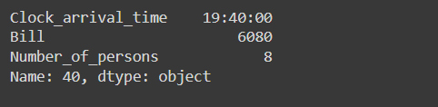
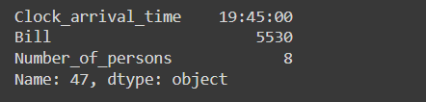
DAY - 4
DAY - 5
OBSERVATIONS
Day-3 has the highest revenue at 7:14 pm with number of persons being 8.
7:14 PM on Day 3 is a peak time for generating high revenue, likely because it represents a popular dining or activity time, possibly during dinner or another high-demand period.
This time might reflect when larger groups (like the group of 8) are most likely to visit, increasing the average bill significantly.

Slide 23
CONCLUSION
Day 4 shows the strongest relationship between the number of reservations, persons, and the bill, with an R-squared value of 0.960, indicating a significant impact of these factors on revenue.
Day 3 has the highest average bill, suggesting that promotions or marketing strategies on this day can maximize profits, particularly targeting larger groups.
Day 5 shows the longest waiting times, indicating a need for better management or operational improvements to enhance customer satisfaction and service efficiency during peak periods.

Slide 24
Link of co-lab
Day - 1,2
https://colab.research.google.com/drive/1C8j9Jrj2GGlwfGPr_RpEhK3_ry6LCkm0?usp=sharing
Day – 3,4,5
https://colab.research.google.com/drive/1u3DRWv4cAl8vzvjk9OkbTsjWfJwu6cme?usp=sharing

